Slide 2

Amazon S3
Amazon Simple Storage Service (Amazon S3)

Slide 3
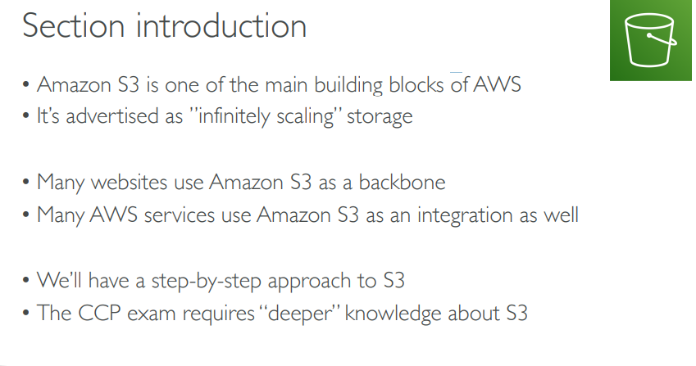

Slide 4
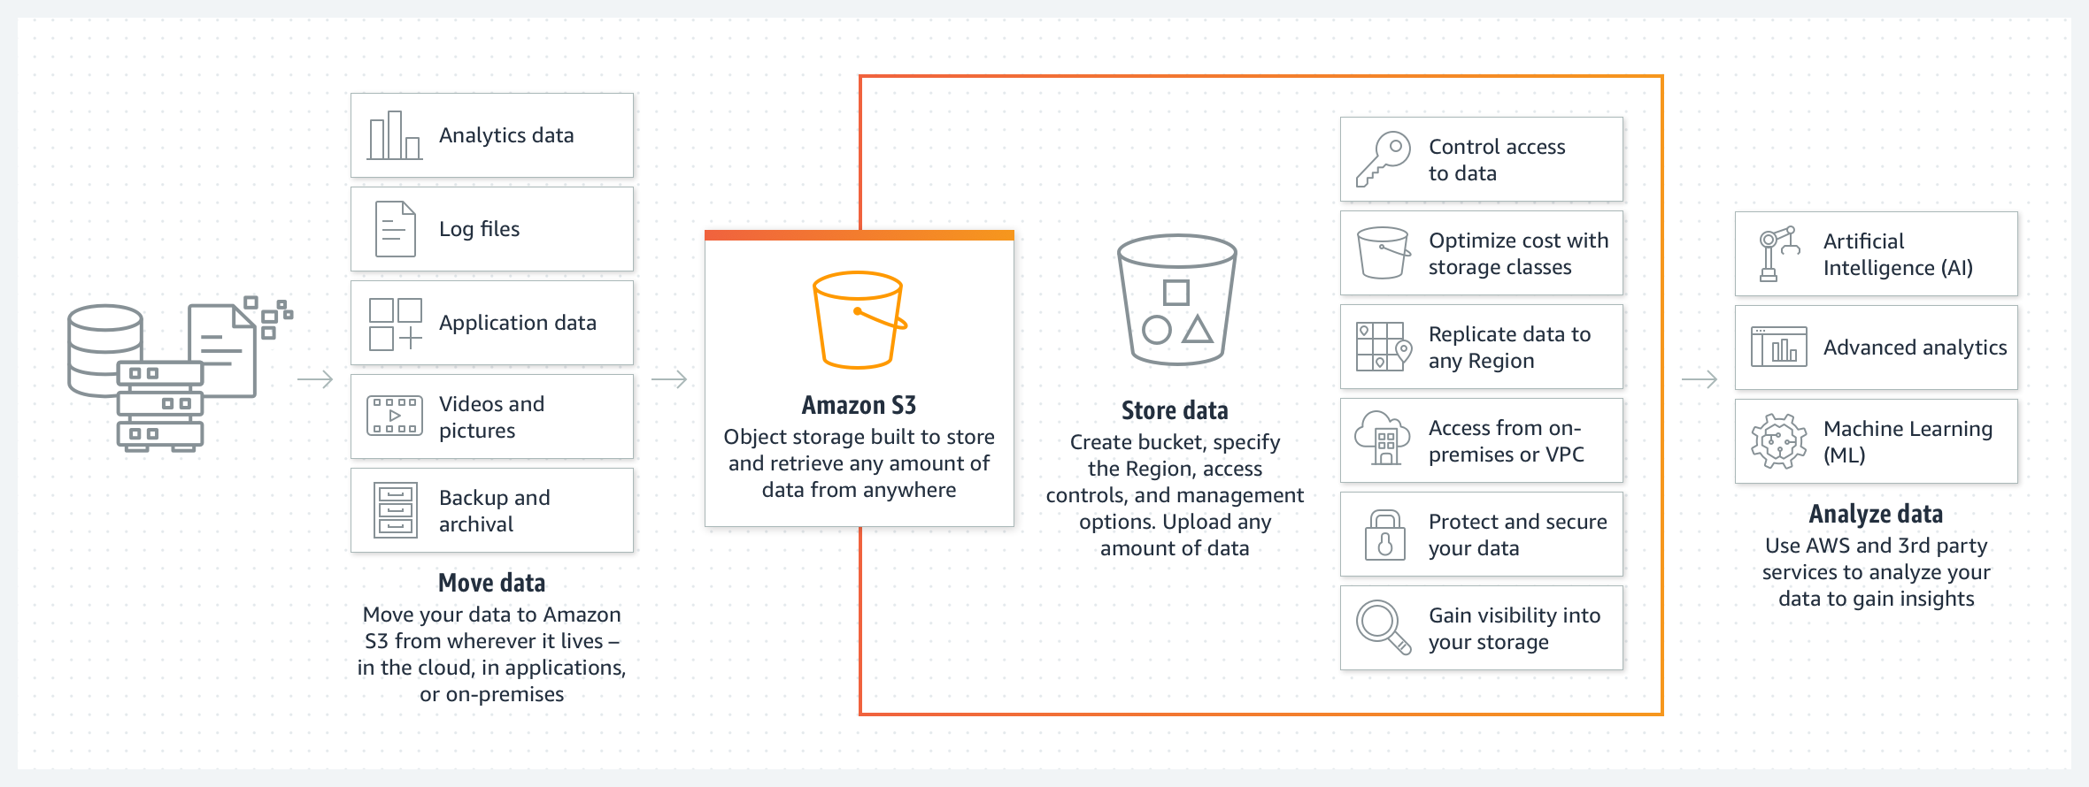
Architecture of S3

Slide 6
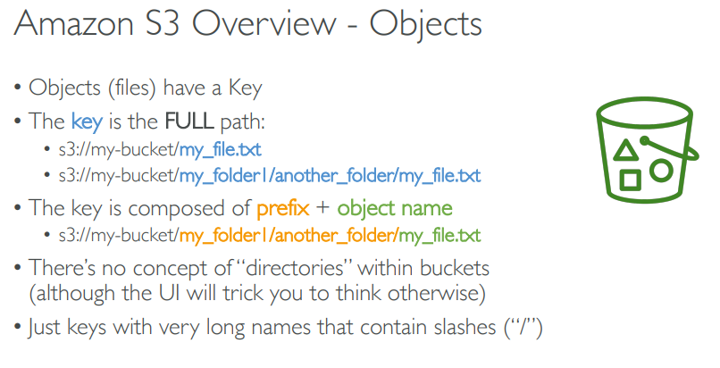

Slide 7
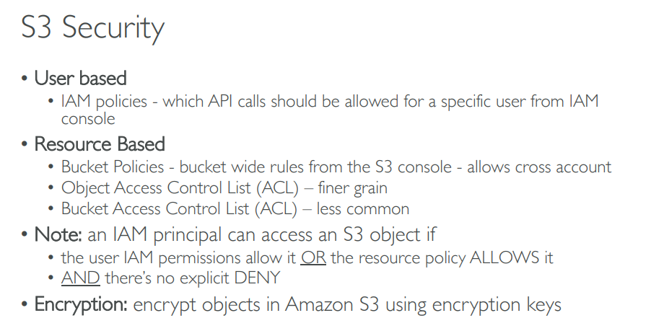

Slide 10


Slide 11
AWS S3 Benefits
Some of the benefits of AWS S3 are:
Durability: S3 provides 99.999999999 percent durability.
Low cost: S3 lets you store data in a range of “storage classes.” These classes are based on the frequency and immediacy you require in accessing files.
Scalability: S3 charges you only for what resources you actually use, and there are no hidden fees or overage charges. You can scale your storage resources to easily meet your organization’s ever-changing demands.
Availability: S3 offers 99.99 percent availability of objects
Security: S3 offers an impressive range of access management tools and encryption features that provide top-notch security.
Flexibility: S3 is ideal for a wide range of uses like data storage, data backup, software delivery, data archiving, disaster recovery, website hosting, mobile applications, IoT devices, and much more.
Simple data transfer: You don’t have to be an IT genius to execute data transfers on S3. The service revolves around simplicity and ease of use.

Slide 12


Slide 13
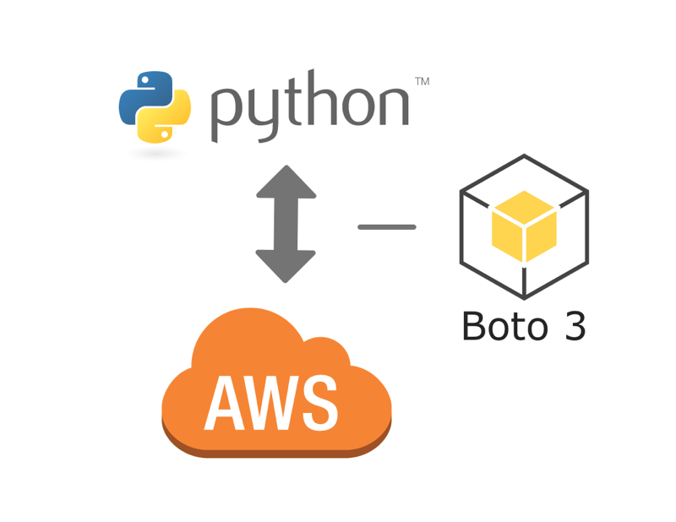
What is Boto 3 ?
The AWS SDK for Python is called Boto3. It is used to create, configure, and manage AWS services, such as Amazon Elastic Compute Cloud (Amazon EC2) and Amazon Simple Storage Service (Amazon S3). The SDK provides an object-oriented API as well as low-level access to AWS services.

Slide 14
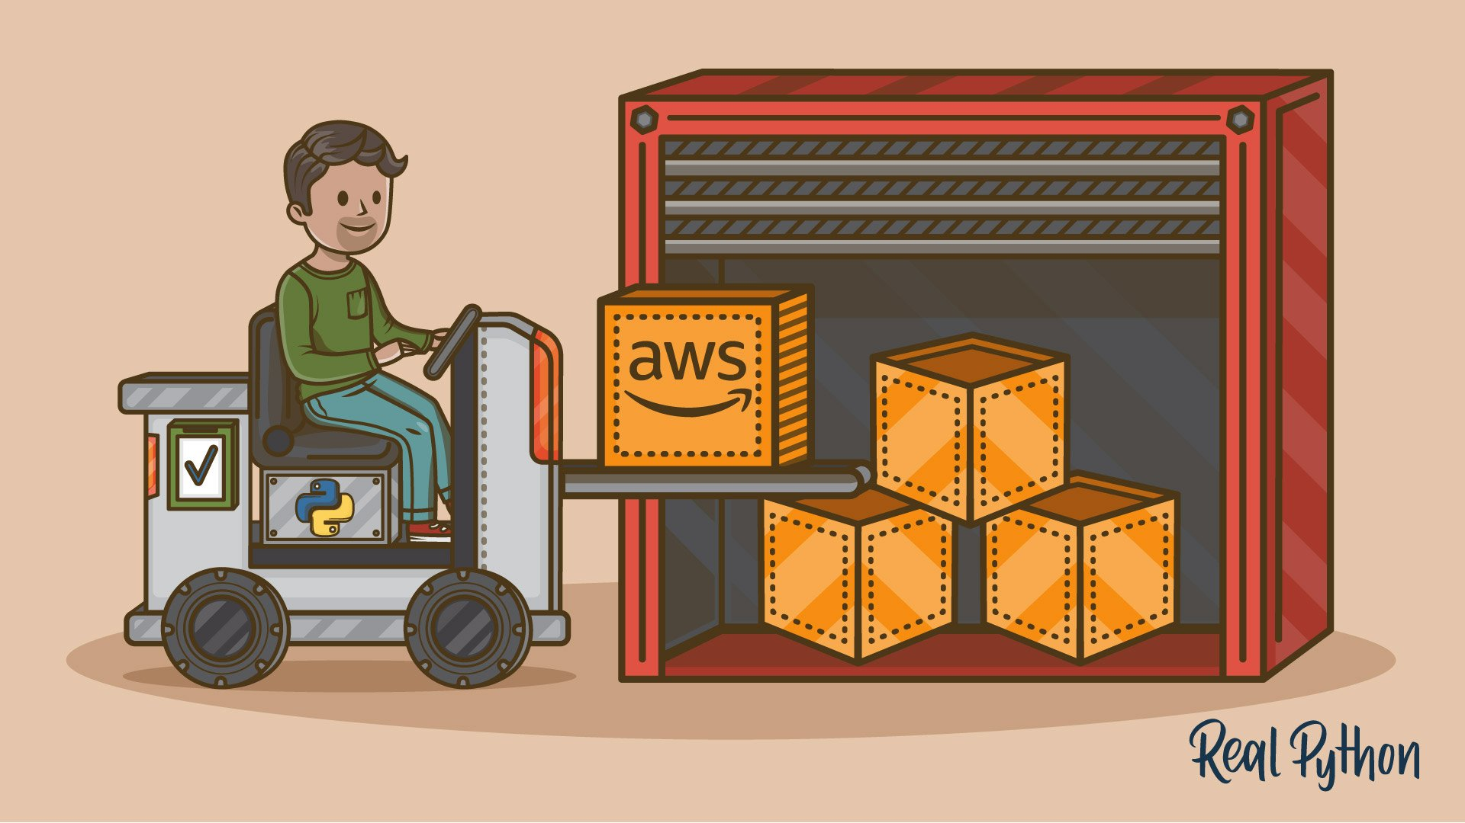

Slide 15
Let’s move to Demo

Slide 16
Amazon S3 – Summary
S3 Buckets
S3 Objects
S3 security: IAM policy, S3 Bucket Policy (public access)
S3 Versioning: multiple versions for files, prevent accidental deletes
S3 Encryptions :
S3 Benefits : Durability, low cost, scalability, flexibility ..etc.
Access AWS-S3 using Boto3

